Slide 1
Cost and Design and Medical Device, oh my!
RET is funded by the National Science Foundation,
grant # EEC-1404766
April 1st, Culmination Event for COFSP Fellows

Slide 2
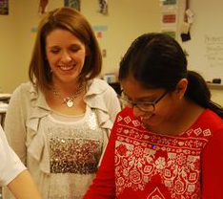
Alyssa George
Biomedical engineering, UC ’16
COFSP Fellow
Amanda Sopko
Indian Hill Middle School
6th Grade RET Math Teacher

Slide 3
Engineering Design Process: Cost and Design
Standards:
Asking questions (for science) and defining problems (for engineering)
Constructing explanations (for science) and designing solutions (for engineering)
Designing Technological/Engineering Solutions using science concepts

Slide 4
Activity
Title:
Cost and Design Comparison
Activity Outline
Students made a device that mimicked the function of a laparoscopic closure device
Constraints: Cost, time
Were tasked to “make it better” and create a device with better value
Guiding Questions:
What is the relation between cost and design?
What is the relation between constraints and design?
What is the engineering design process?
Objectives:
Compare
the costs of alternate designs
medical device design to the engineering design process
the different effects of constraints on alternate designs

Slide 5
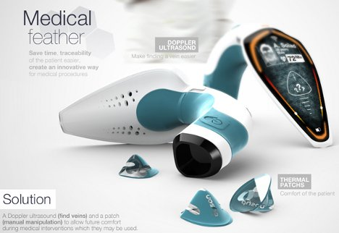
Applications:
Medical device design
Careers:
Biomedical engineers
Mechanical engineers
Cost analysts
Regulatory analysts
Society:
Gold standard medical devices
Relation between cost and function

Slide 6
Student Test Data

Slide 7
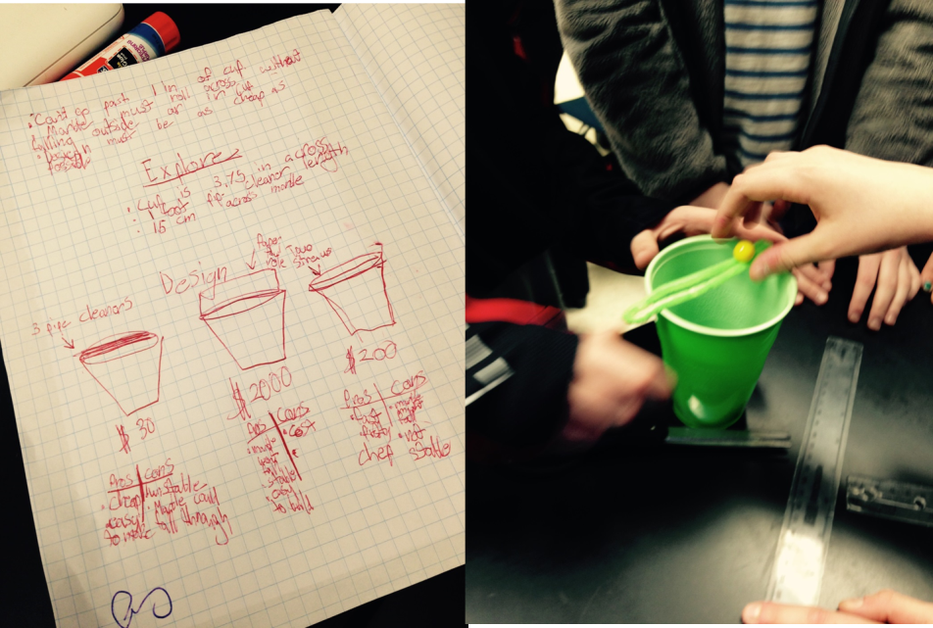
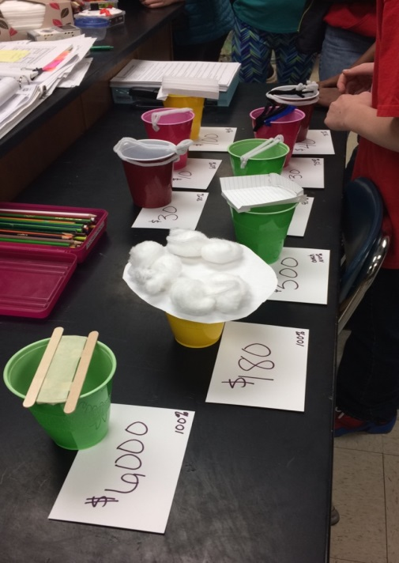
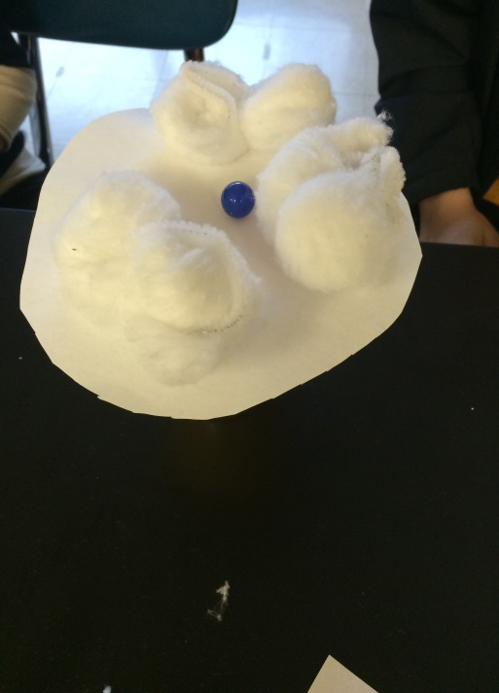
Activity in Action
Students were taught about medical device design
Students worked in teams to brainstorm ideas considering constraints, particularly cost
Teams built multiple prototypes and then improved on them to make them more competitive

Slide 8
Reflections
Successes
Every student involved
Had the opportunity to solve a “real world” problem
Creative solutions
Emphasis on “make it better”
Interesting discussion
Improvements
Pre and Post test could have been more challenging
Could have been more constraints
Activity may have been better suited for older students

